Slide 1

Observation, Reflection and Containment:
A PSYCHOANALYTIC APPROACH TO WORK WITH UNDER FIVES

Slide 2
Louise Emanuel (MPsychPsych, PhD in Progress)
CONSULTANT CHILD PSYCHOTHERAPIST
HEAD OF LOCAL UNDER FIVES SERVICES, TAVISTOCK CLINIC
CONVENOR INFANT MENTAL HEALTH WORKSHOP
COURSE ORGANISER PGDIP/MA IN INFANT MENTAL HEALTH AND EARLY YEARS DEVELOPMENT
LIST OF PUBLICATIONS AVAILABLE BY E-MAIL
TWO BOOKS: (SLIDES)

Slide 3

UNDER FIVES MODEL
BASED ON:
PSYCHOANALYTIC AND ATTACHMENT THEORY
INFANT/CHILD DEVELOPMENT RESEARCH
OBSERVATIONAL SKILLS

Slide 4
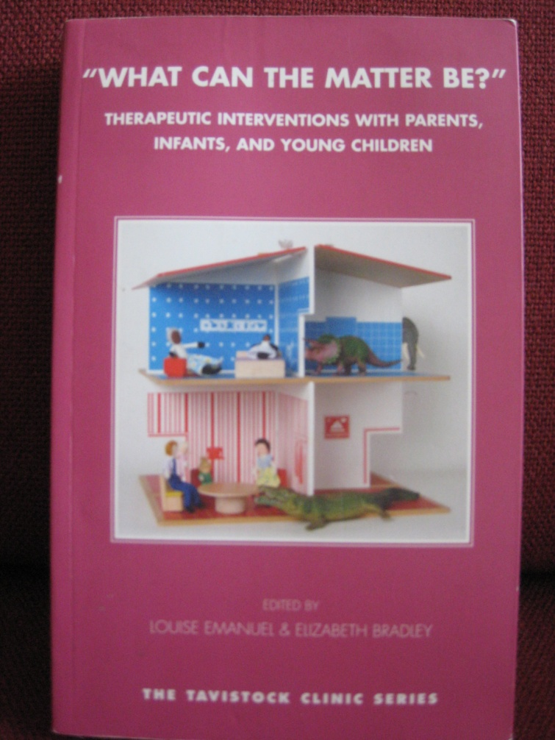

Slide 5
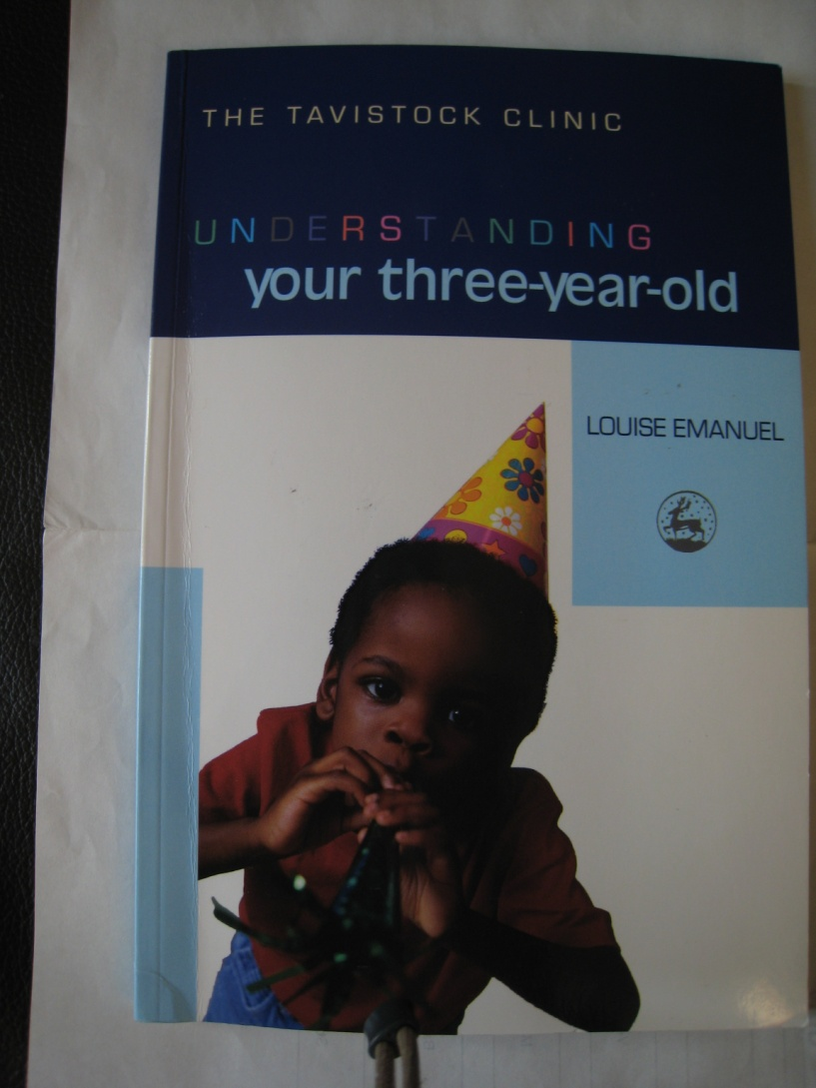

Slide 6
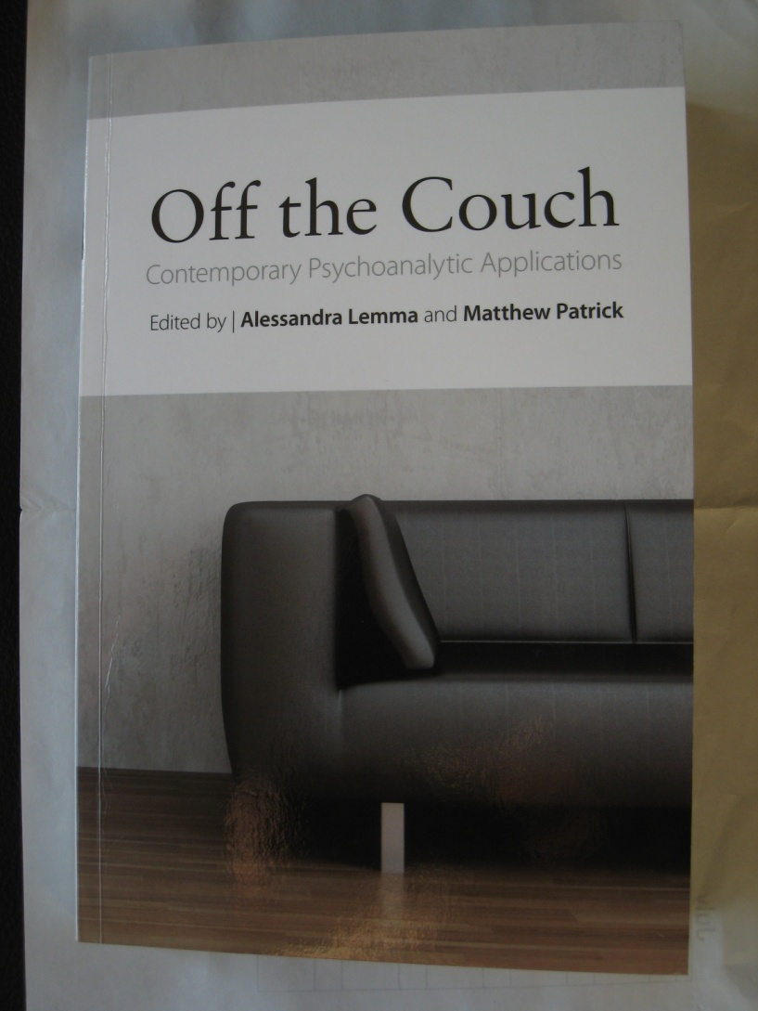

Slide 7
The Development of Mental Apparatus (Bion)
Projective (1)
Identification
(5)
Reverie (2)
(4)
Response (3)
Contained
Container

Slide 8
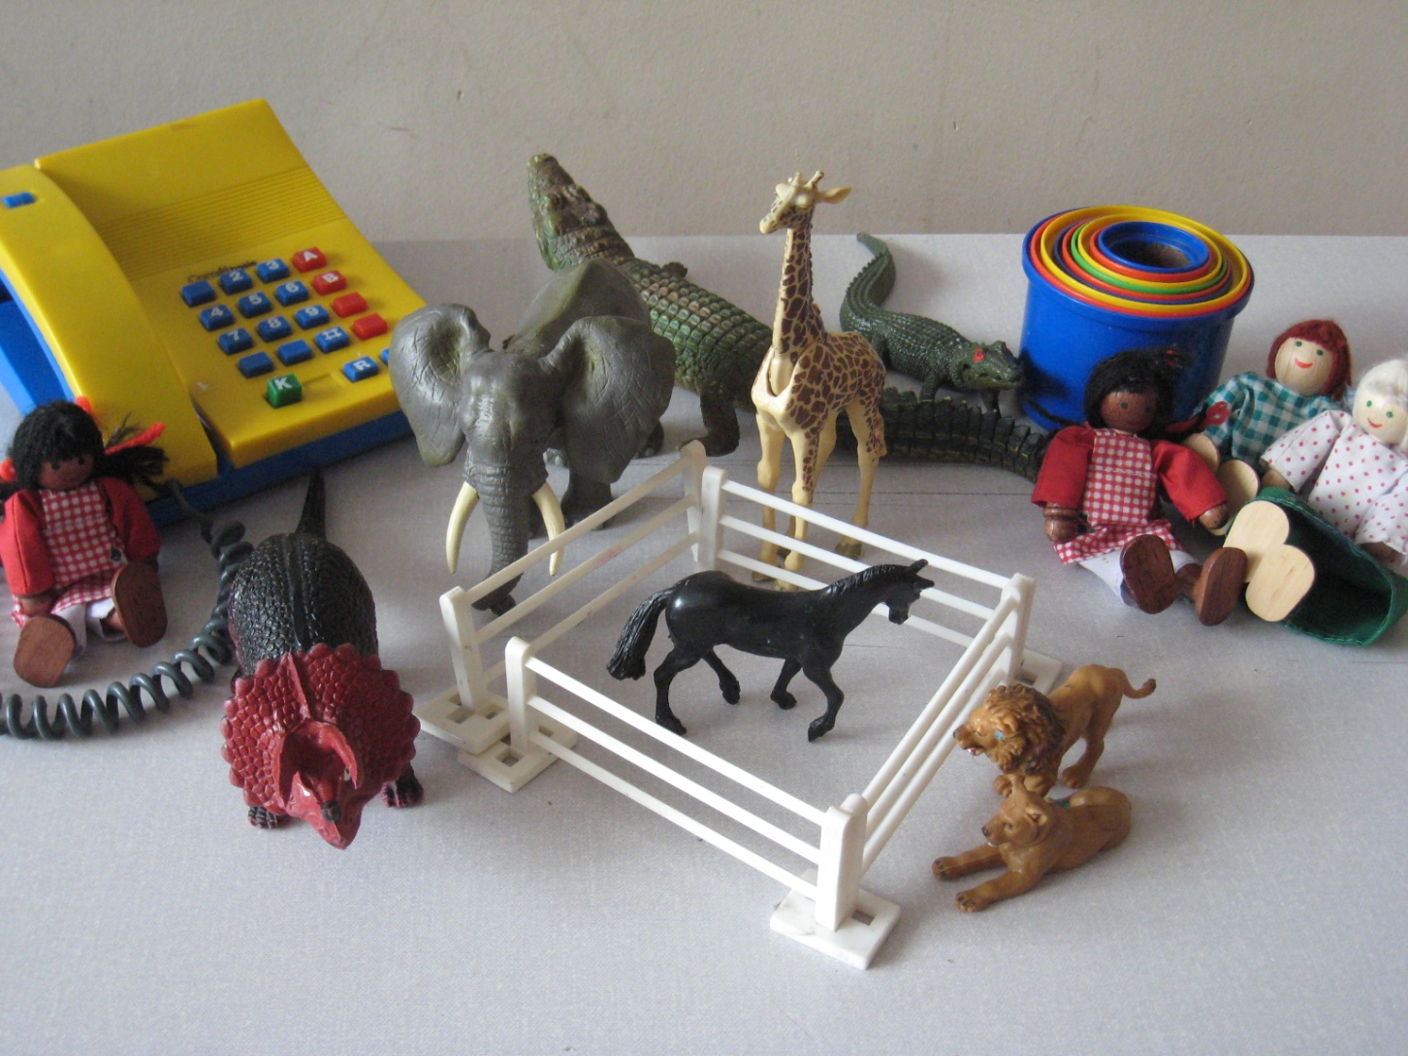

Slide 9
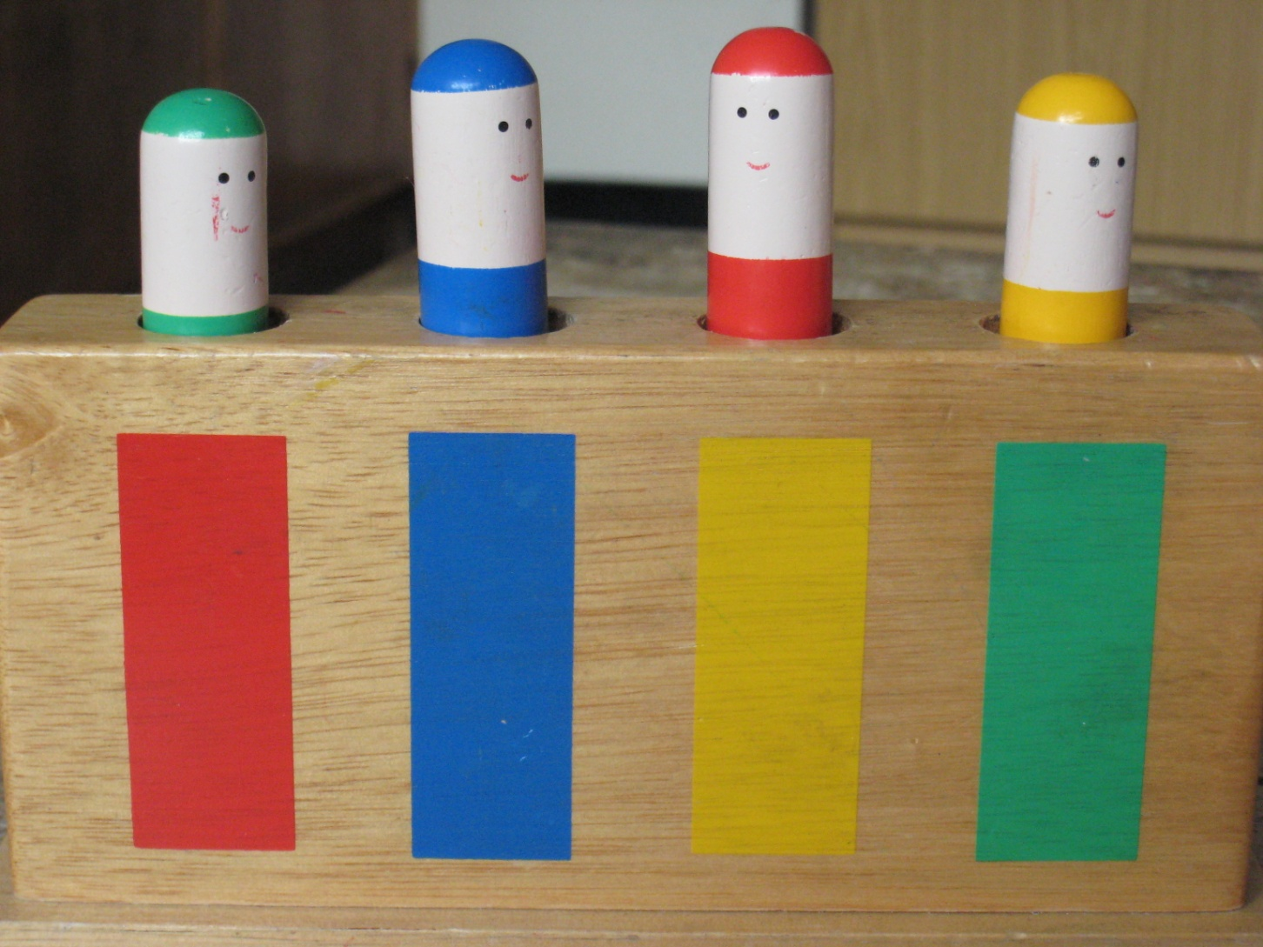

Slide 10
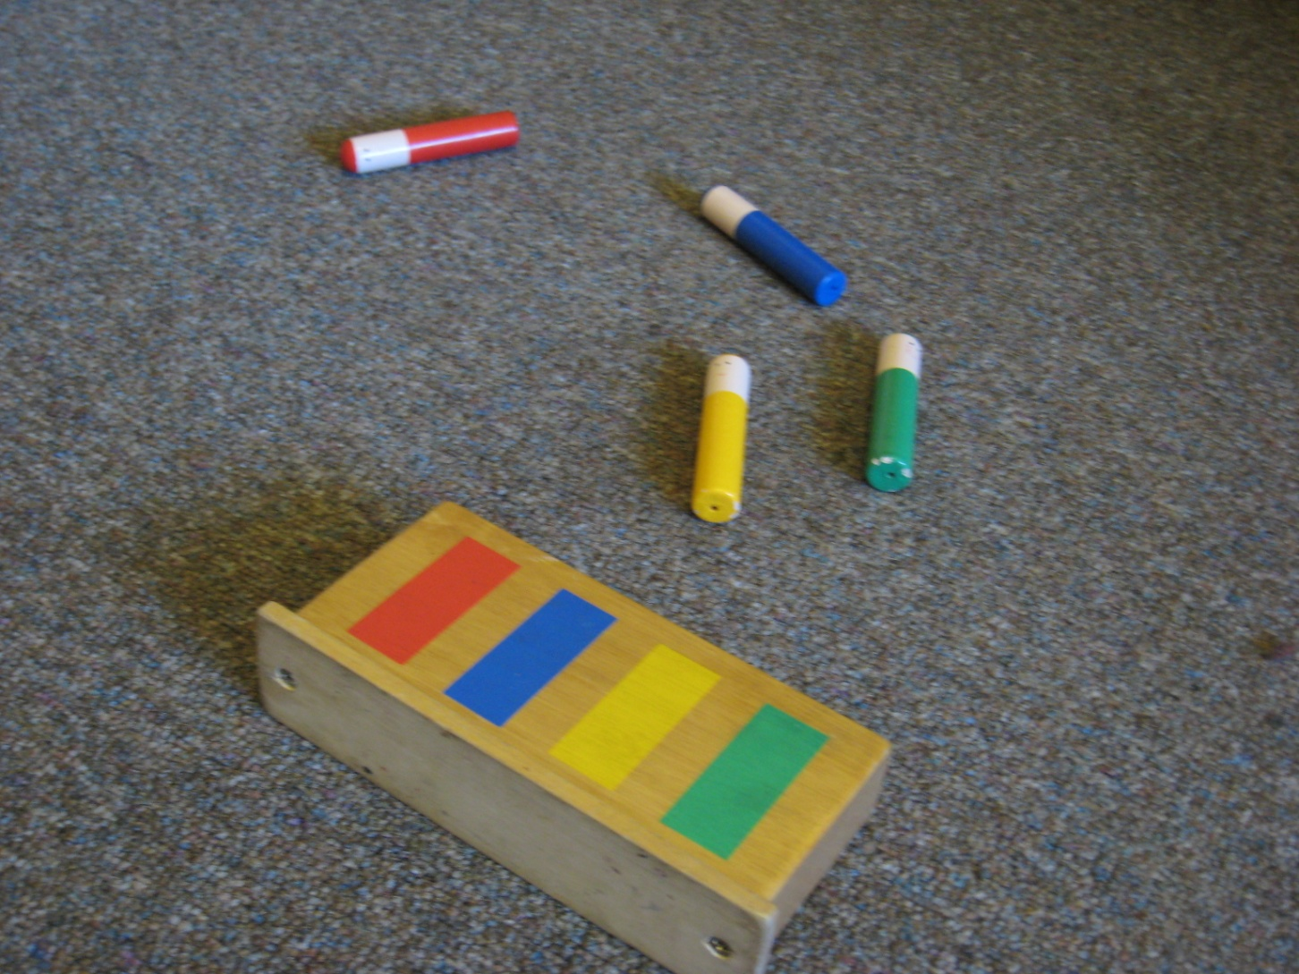

Slide 11
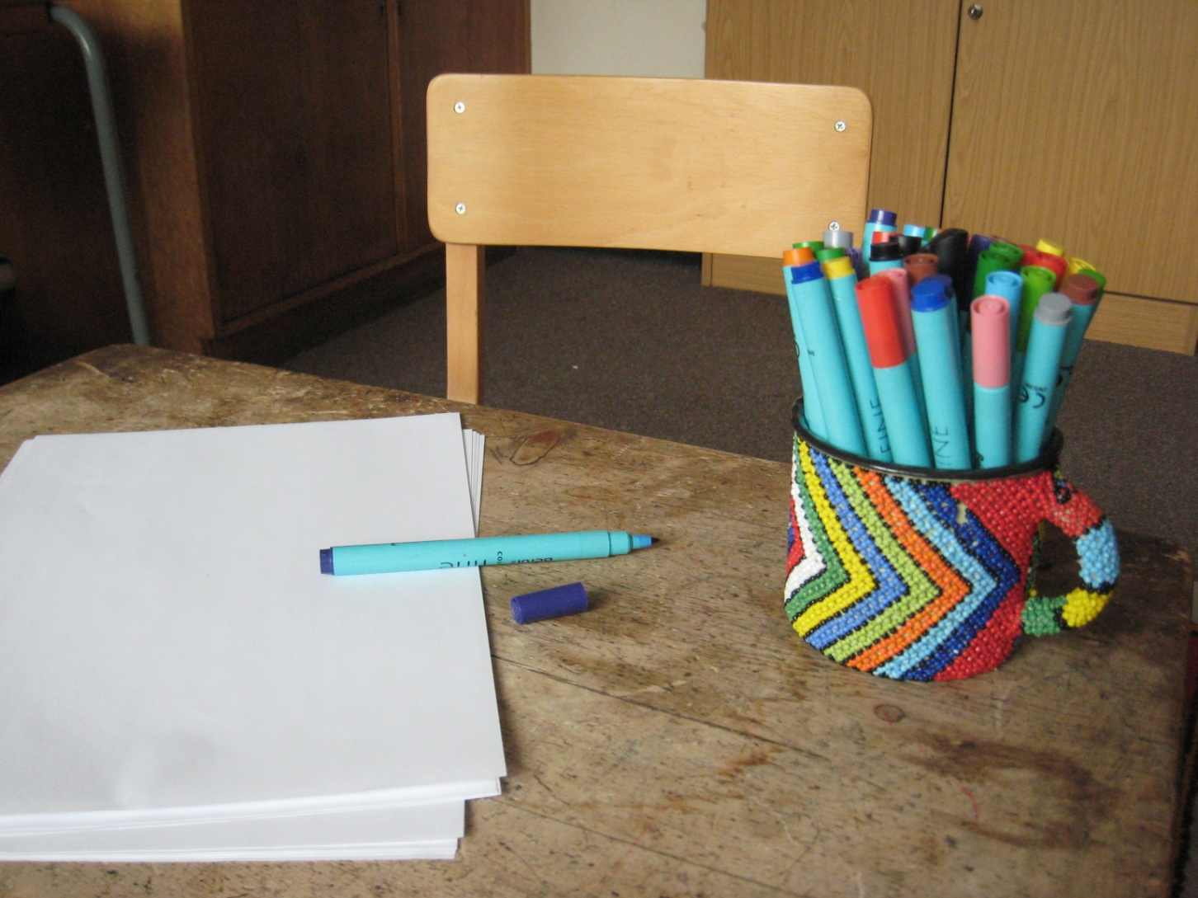

Slide 12
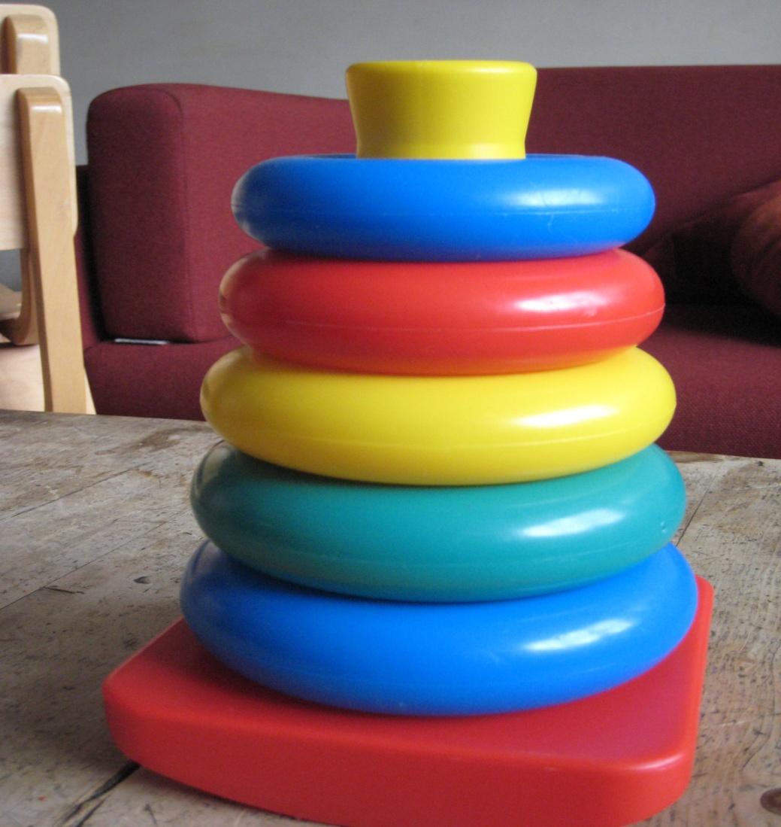

Slide 13
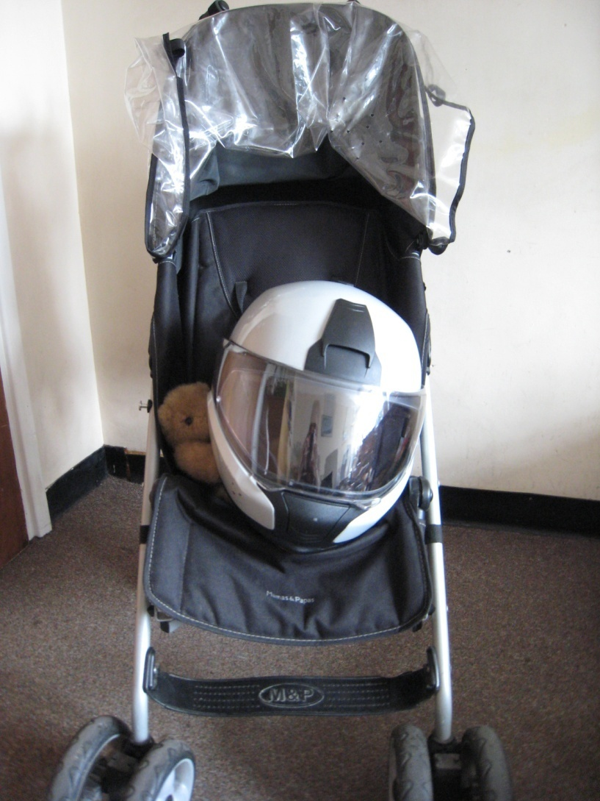

Slide 14
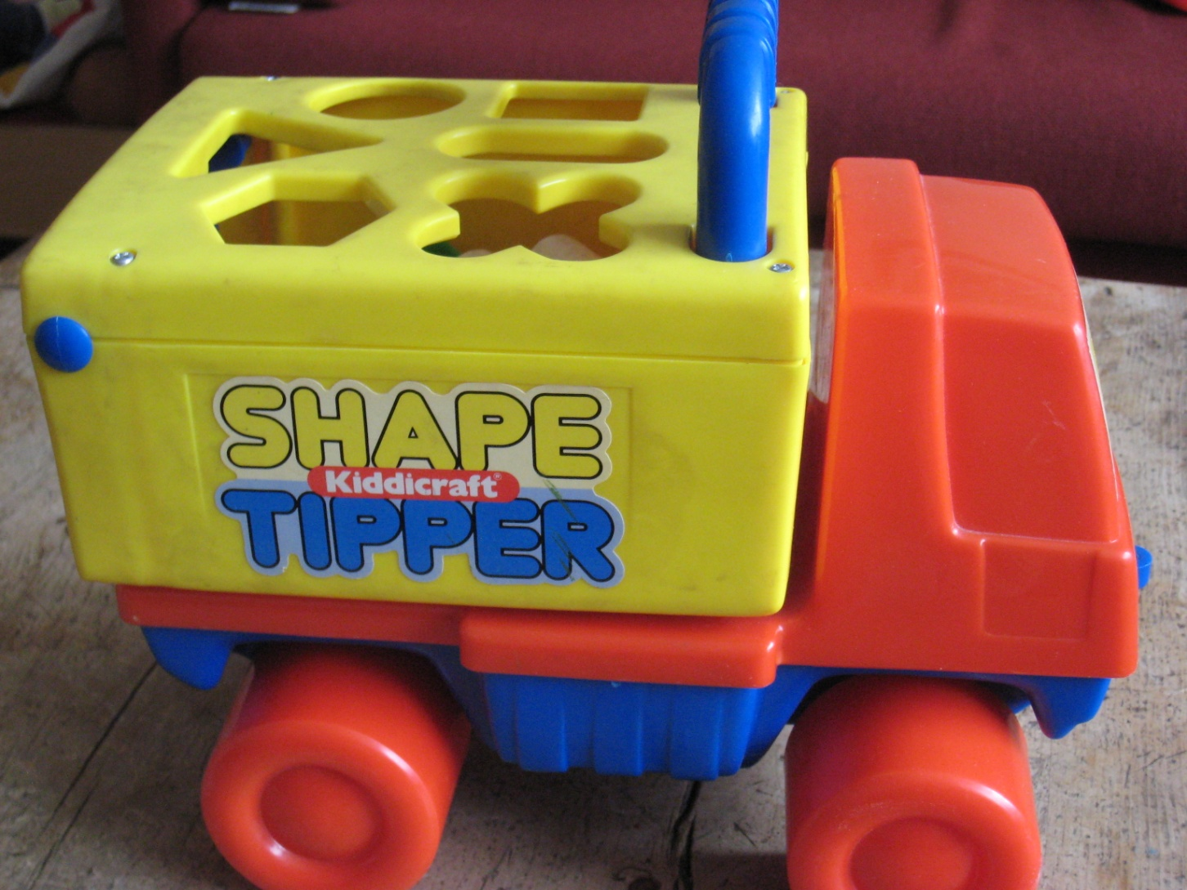

Slide 15
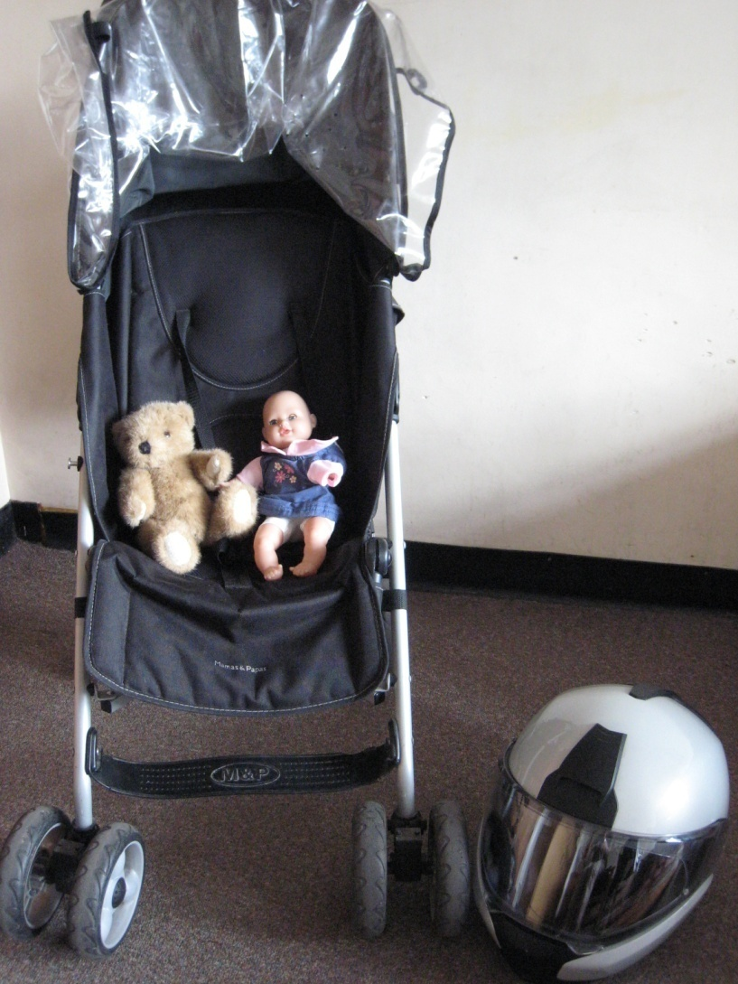

Slide 16
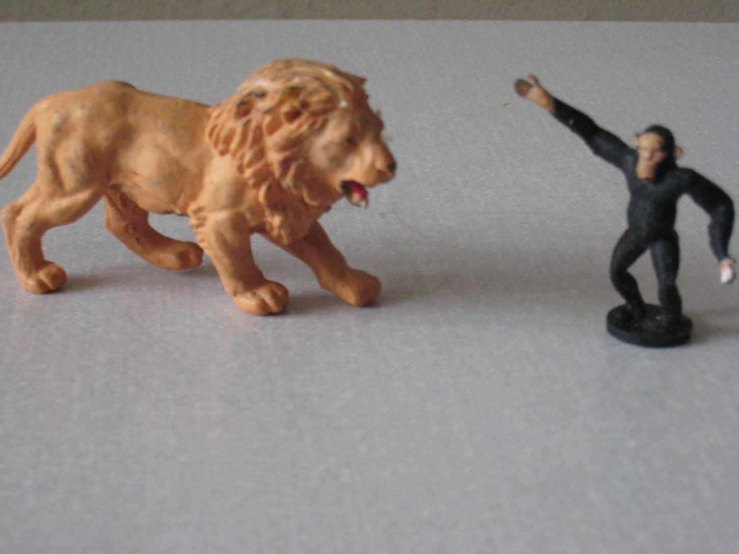

Slide 17
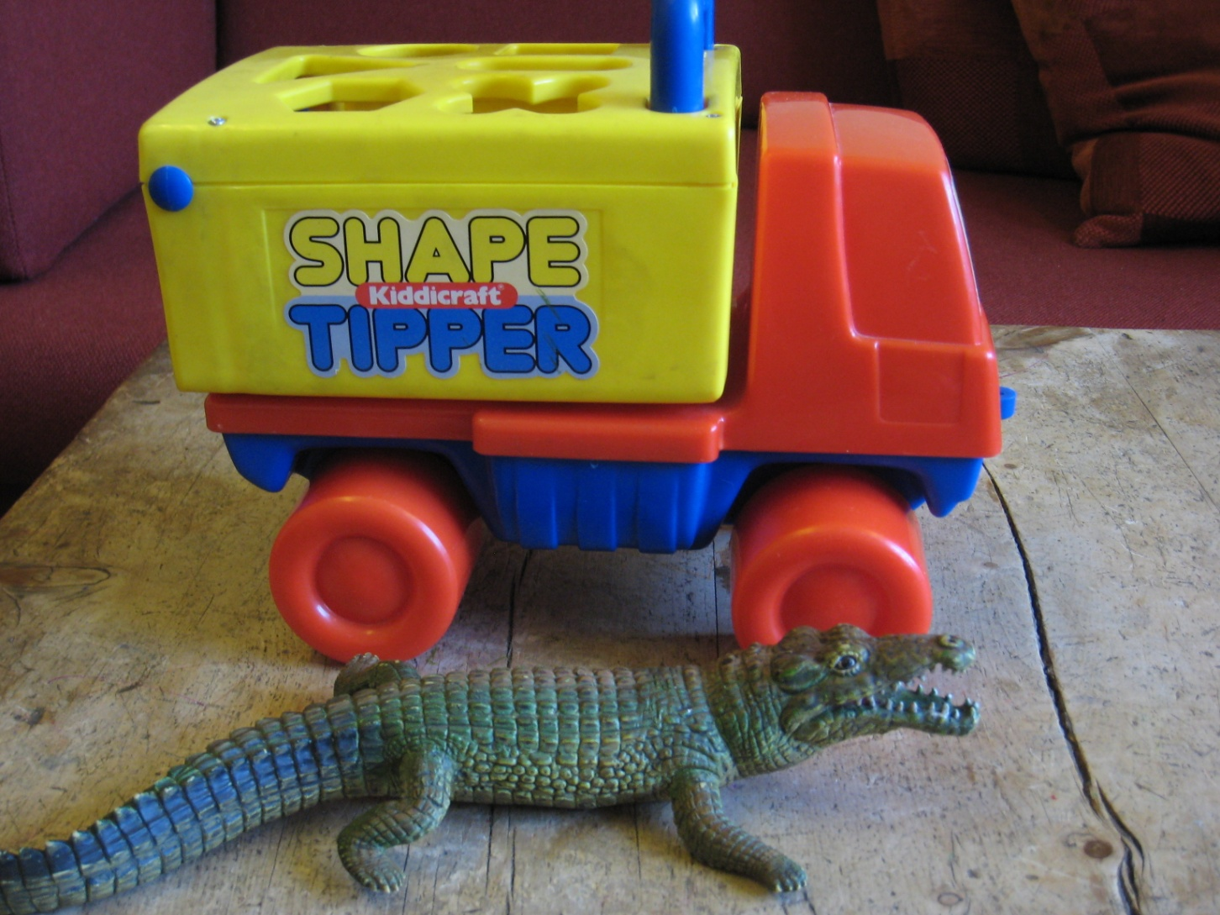

Slide 18
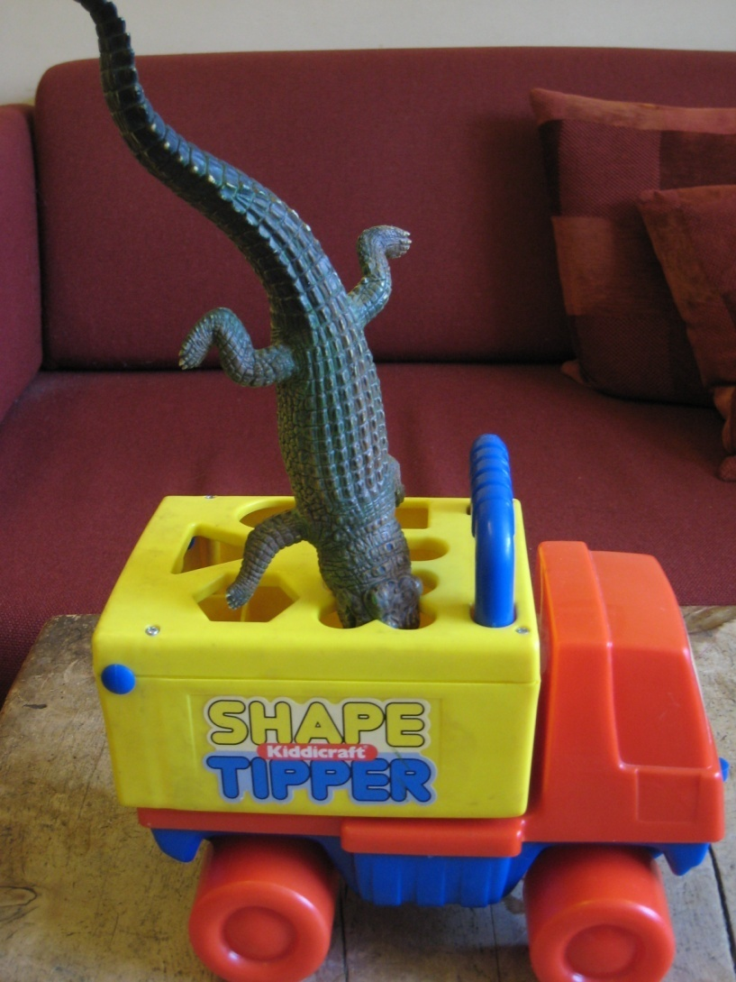

Slide 19
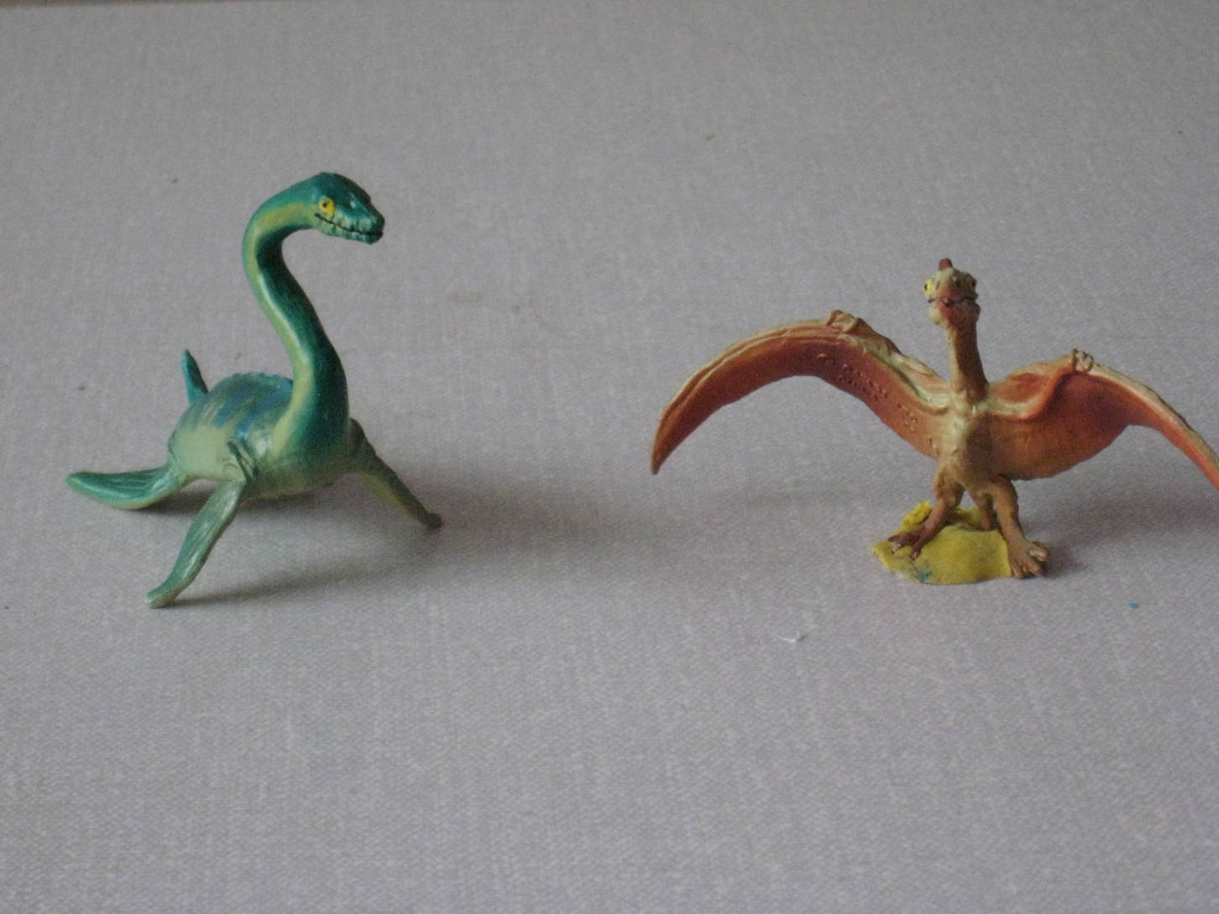

Slide 20
REFERENCES:
EMANUEL, L AND BRADLEY, E (2008):
WHAT CAN THE MATTER BE? Therapeutic Interventions with parents, infants and young children, THE TAVISTOCK CLINIC SERIES, KARNAC BOOKS. INCLUDES CHAPTERS BY: BARROWS, P; DAWS, D; MILLER, L; HOPKINS, J; LIKIERMAN, M; URWIN, C; WITTENBERG, I.
POZZI, M PSYCHIC HOOKS AND BOLTS. PSYCHOANALYTIC WORK WITH CHILDREN UNDER FIVE AND THEIR FAMILIES. LONDON, KARNAC

Slide 21
LOUISE EMANUEL EMAIL ADDRESS:
LEMANUEL@TAVI-PORT.NHS.UK

